Slide 1
Fusilli development
Multi-figure with
Side bar
Front page
Example of model descriptions
Outputs of the models themselves
Reals vs preds
Kfold
Comparison

Slide 2
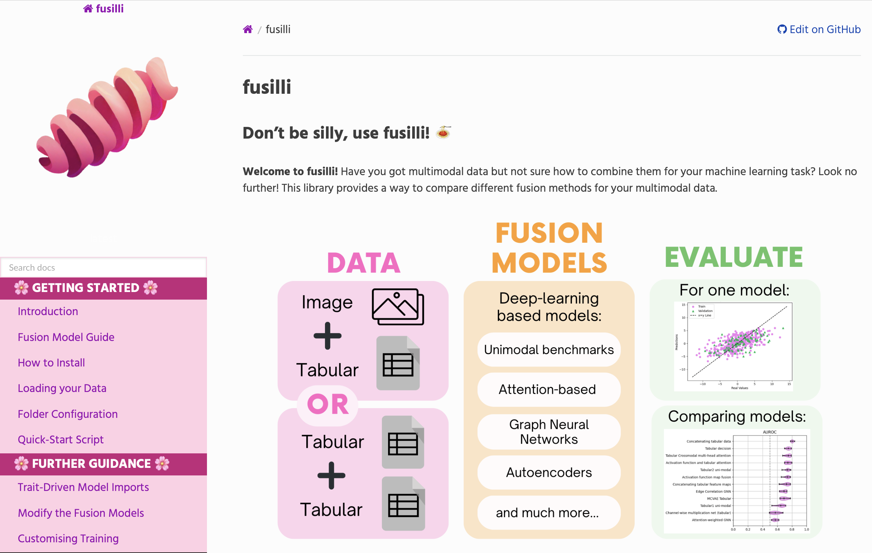
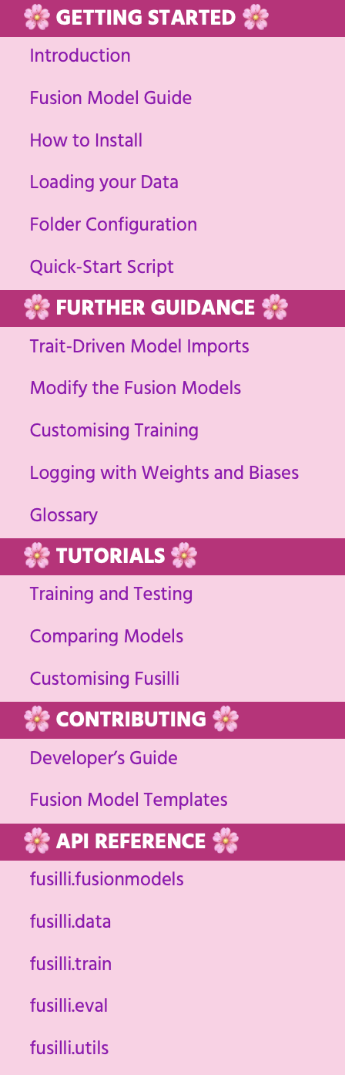
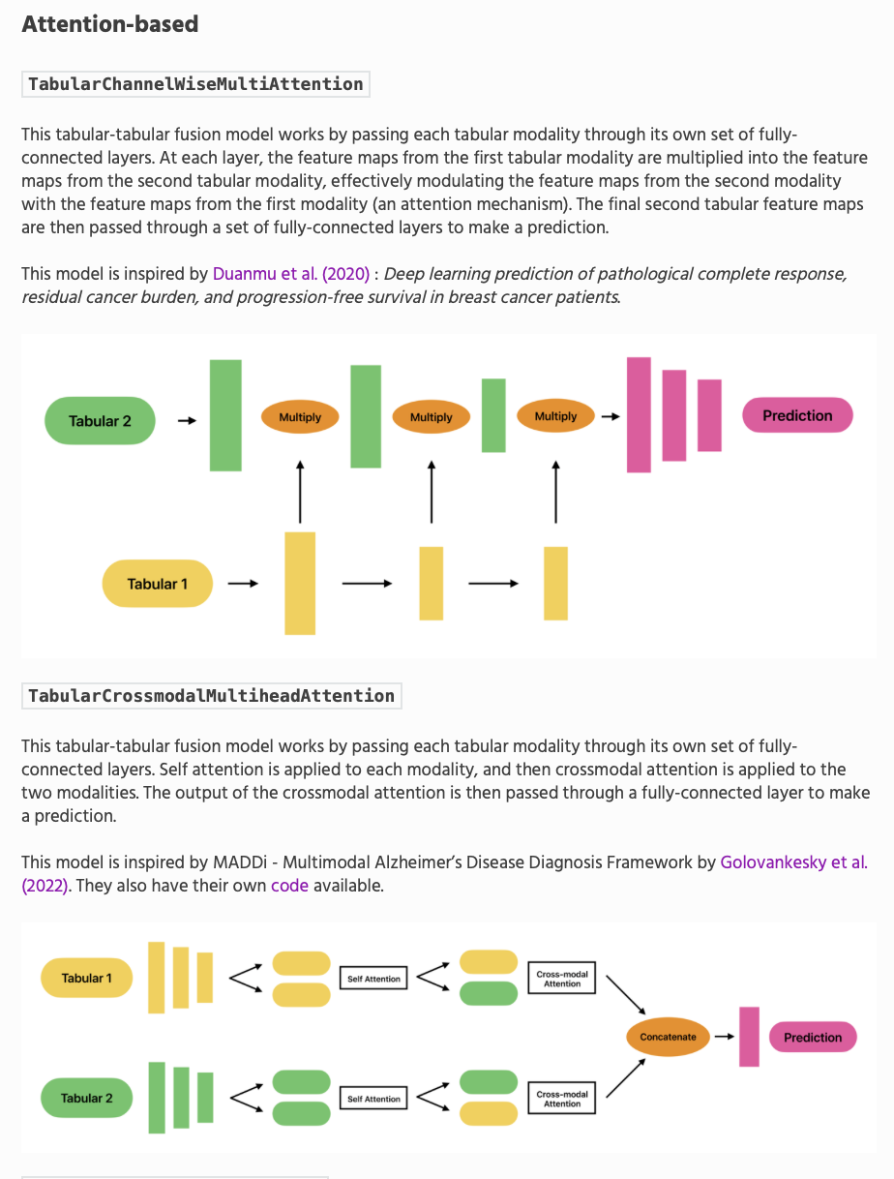
A
C
B

Slide 3
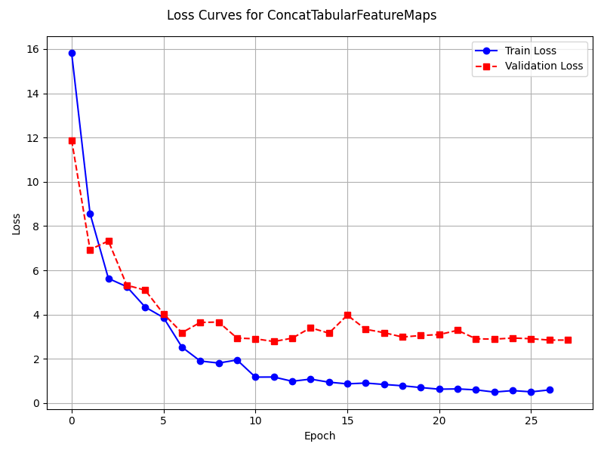
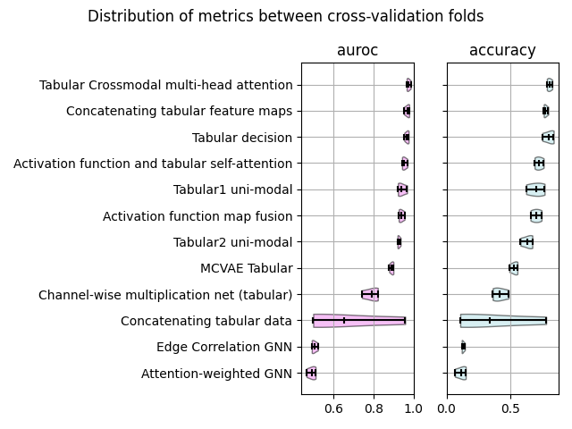
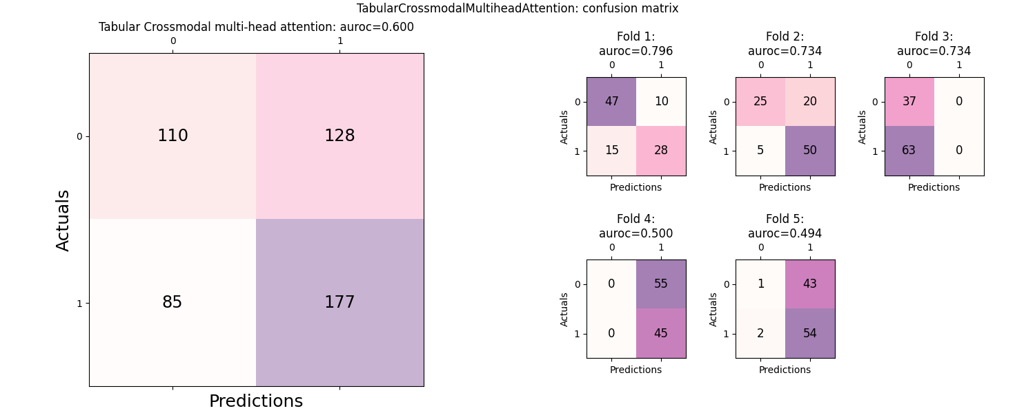
A
C
B

Slide 4
Cox Models
Table of univariable factors
Clinical hazards ratio and Kaplan-Meier curves
Synthseg hazards ratios and Kaplan-meier curves
Multimodal hazards ratios

